Slide 1
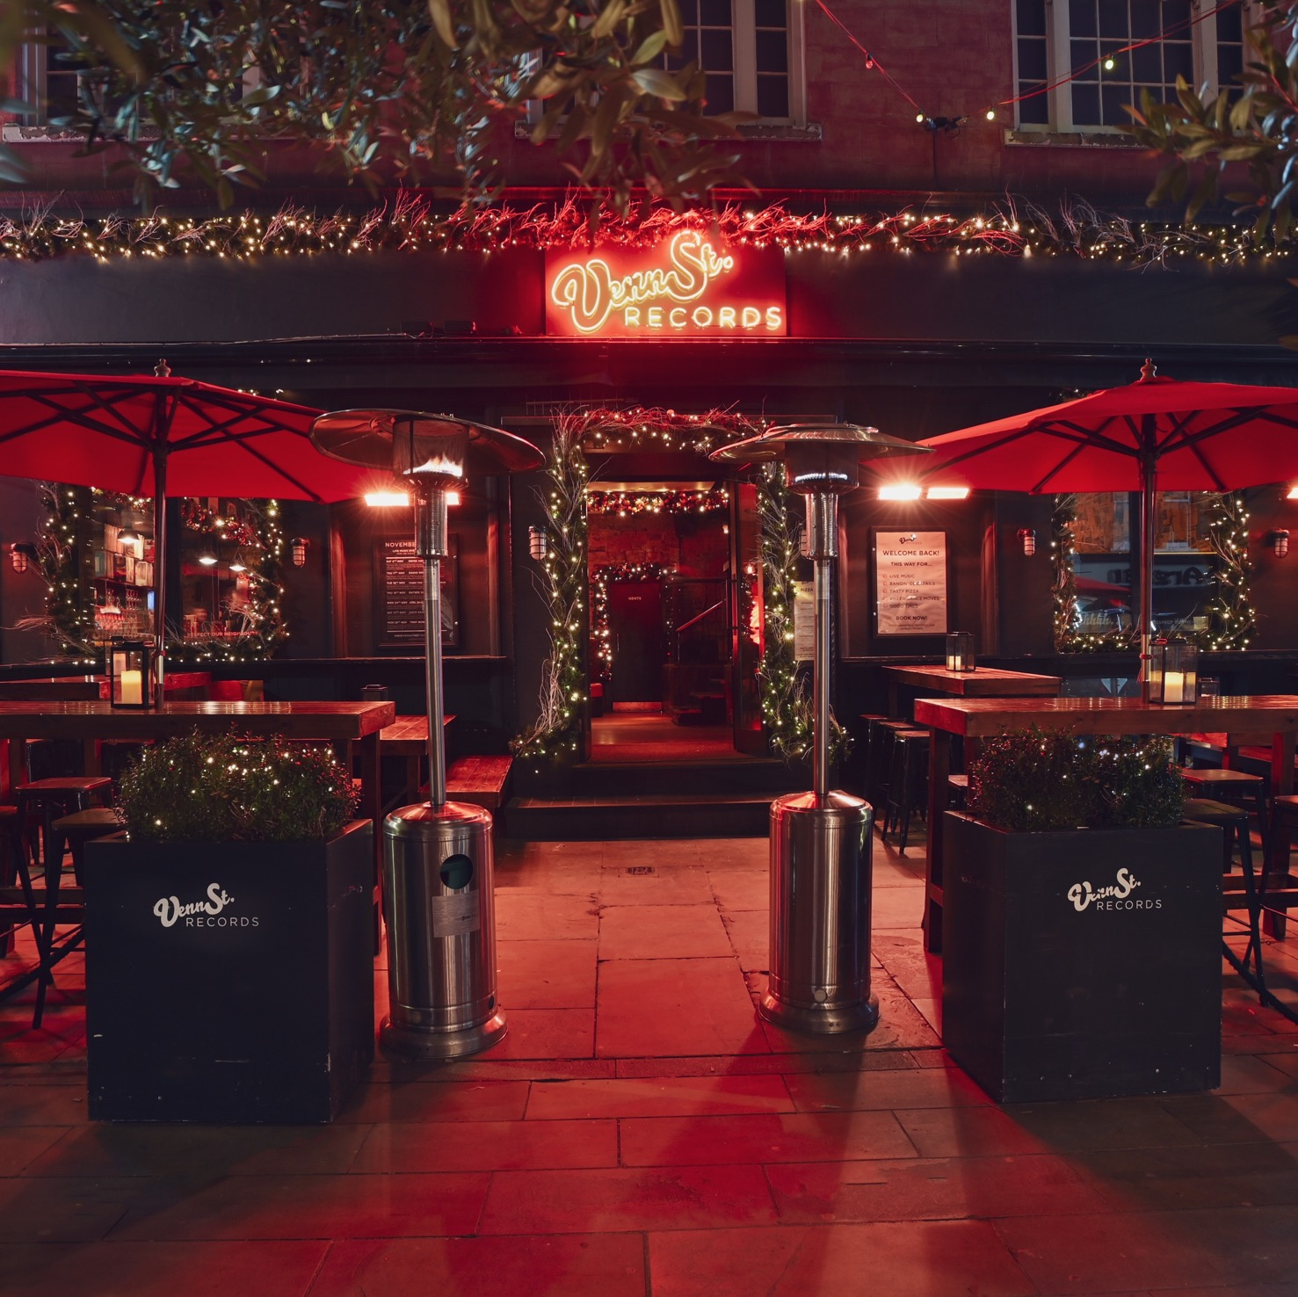
CELEBRATE CHRISTMAS WITH

Slide 2
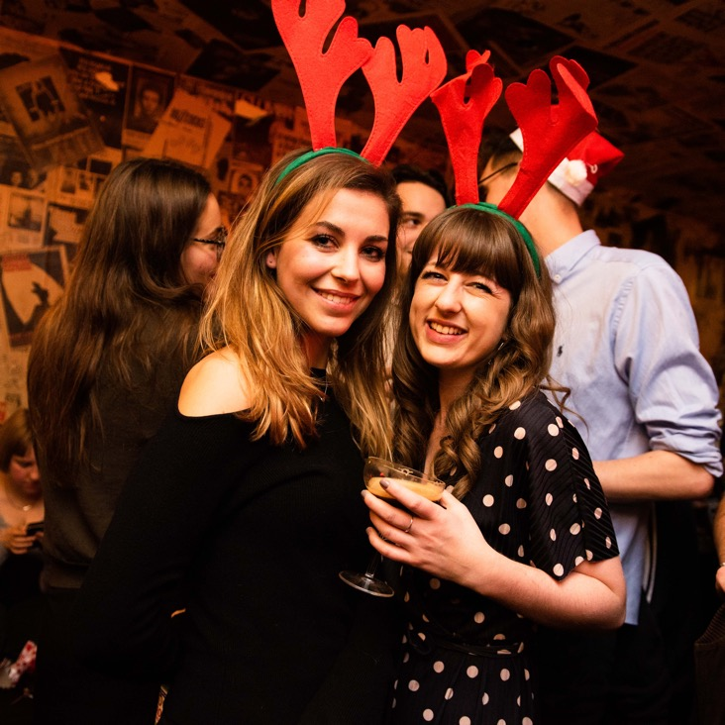
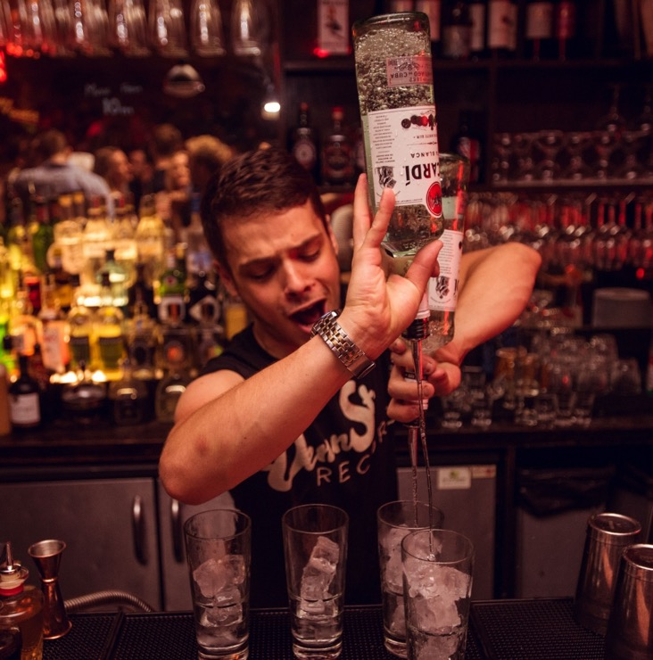
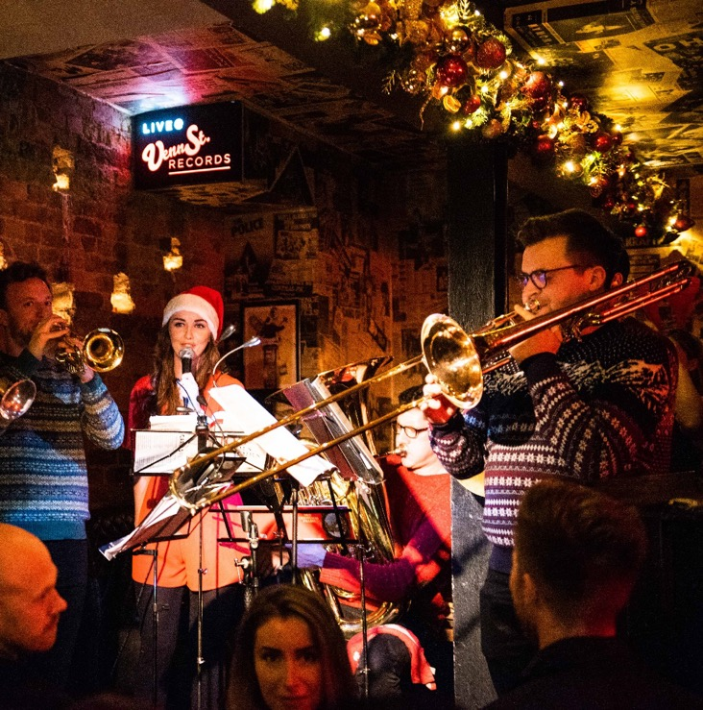
Want your Christmas party to sleigh this year? Leave it to our team to organise your best Christmas party yet.
With both private and open areas, we can help host any size and any style of festive knees-up.
There’s snow party like a
Venn Street Records party.

Slide 3
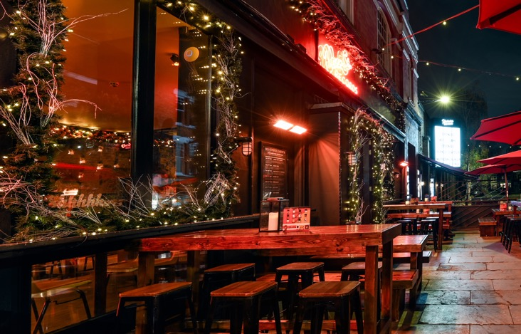
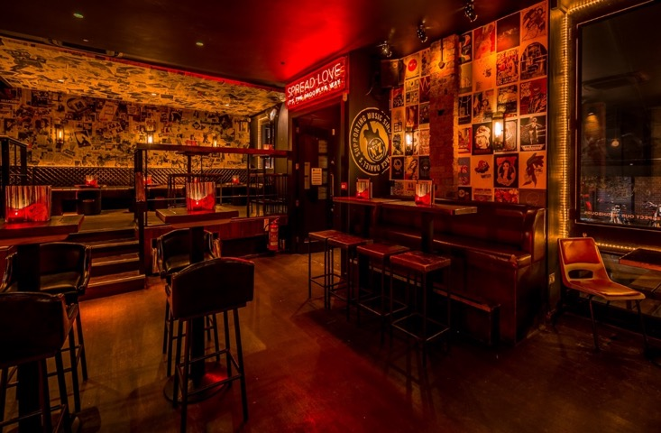
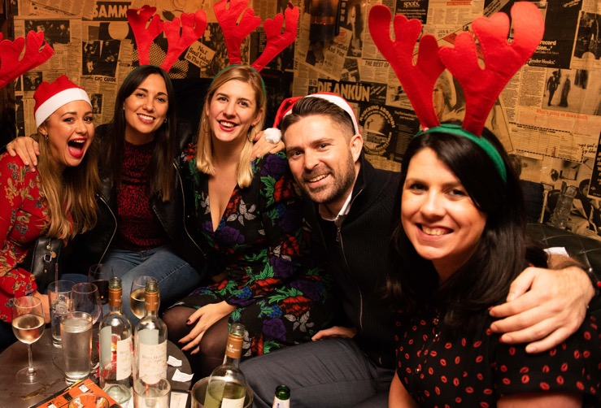
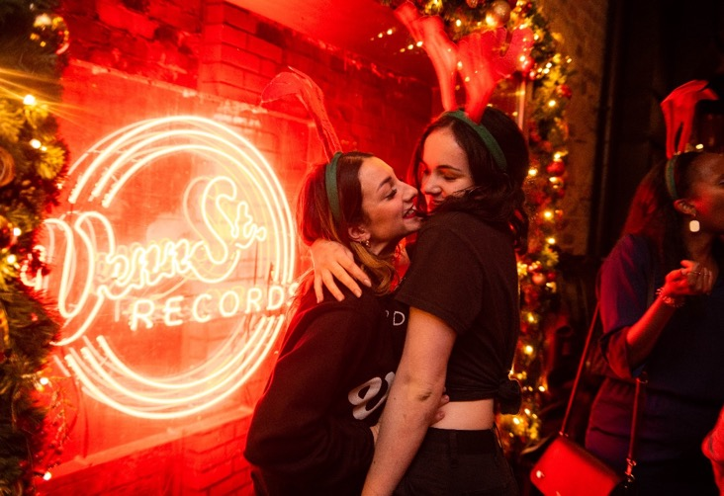
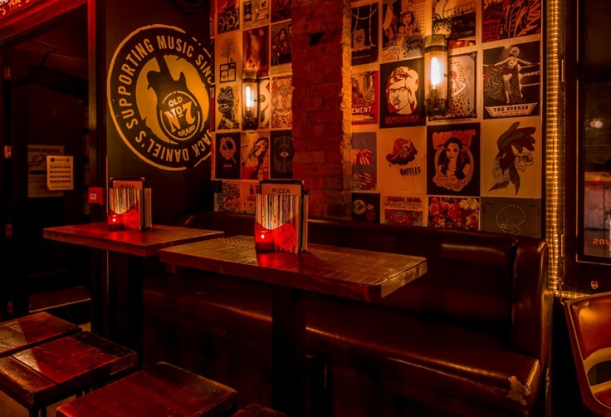
Areas
Tables
6+ people
Booth Spaces
10 – 50 people
Full Venue
150 people

Slide 4
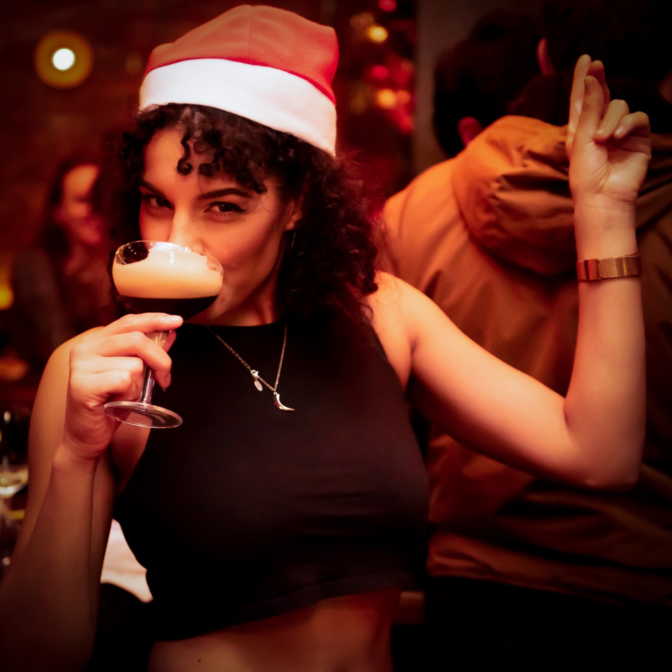
Packages
At The X-Mas Party Hop
£115
12 x Beer
6 x Pizza
Rockin’ Around
£180
2 x Prosecco
12 x Beer
6 x Pizza
Let It Snow
£300
4 x Prosecco
24 x Beer
6 x Pizza
*T&Cs apply

Slide 5
Shot Trays
£65
Serves 12
Santa’s Lil Helpers (Strawberry Margs)
Twisted Tidings (Baby Guinness)
Bundles
Pizza Party: 6 Pizza £55
Prosecco Pack: 2 Prosecco £70
House Wine Bundle: 2 Bottles £40
Camden Beer Bucket: 12 Bottles £65
Cocktail Jugs
£65
Serves 12
Gingle Berry Collins
Bad Santa’s Punch
Records Winter Punch

Slide 6
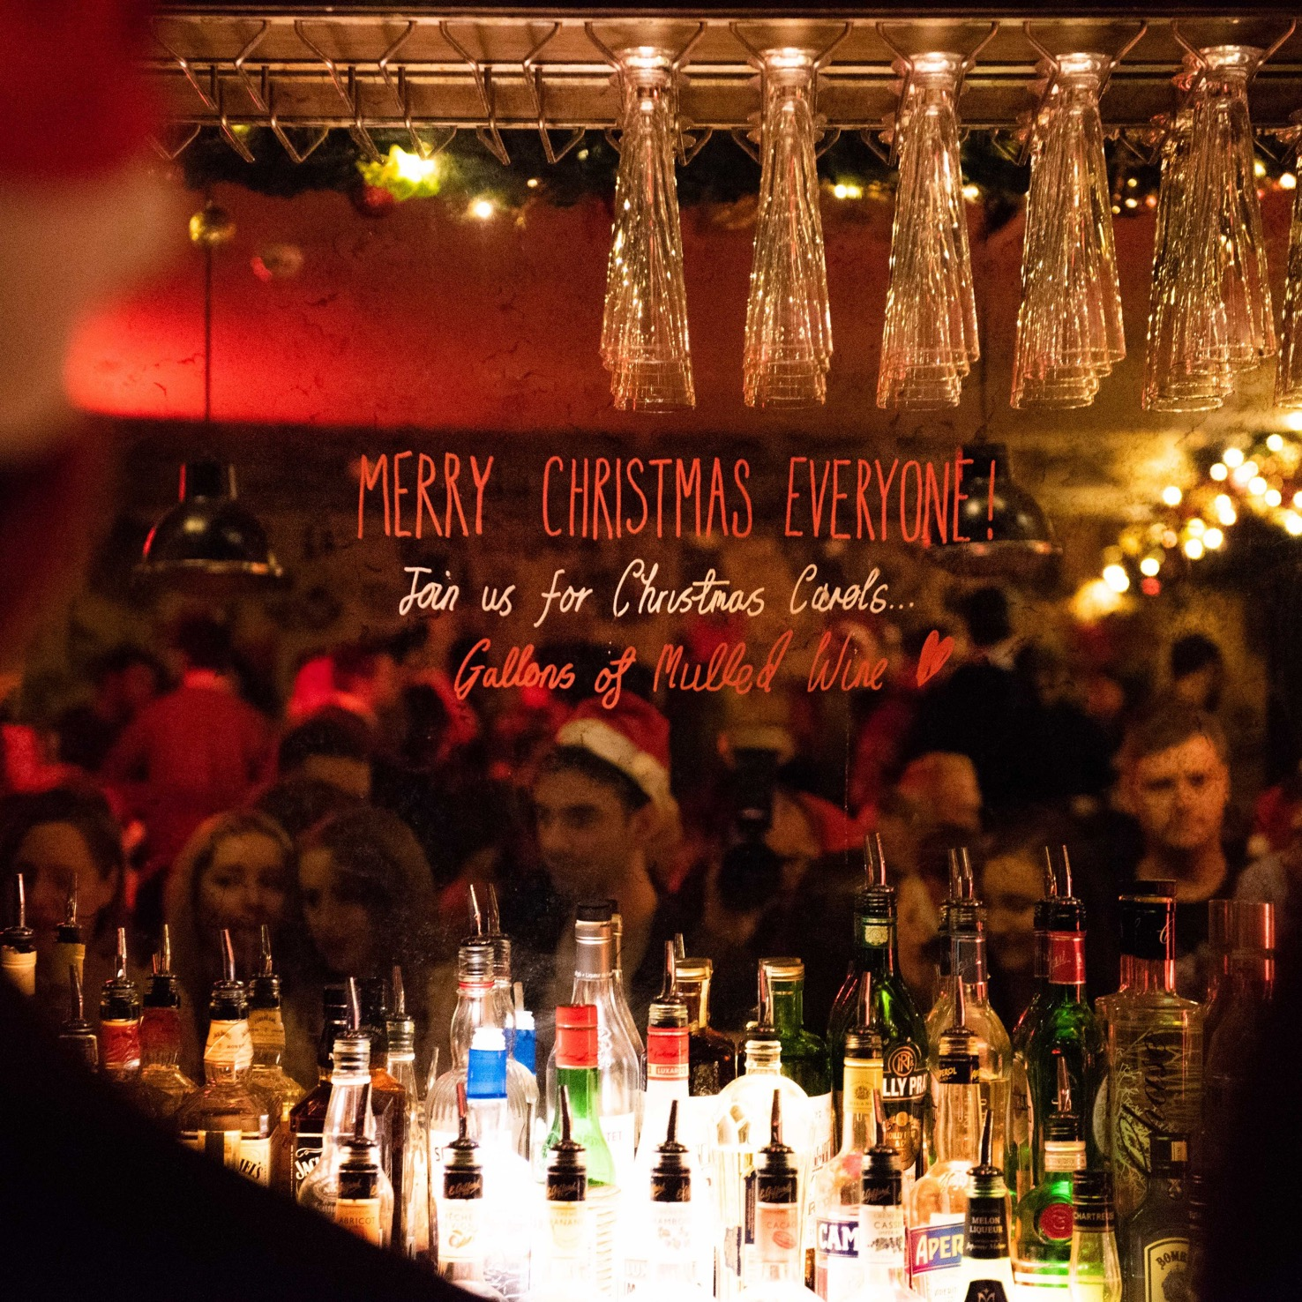
For more information or to arrange a visit,
call our events team on 0203 006 5911 or
send an email to bookings@recordsbars.com
Venn St Records, 78 Venn Street, London SW4 0BD

