Slide 1
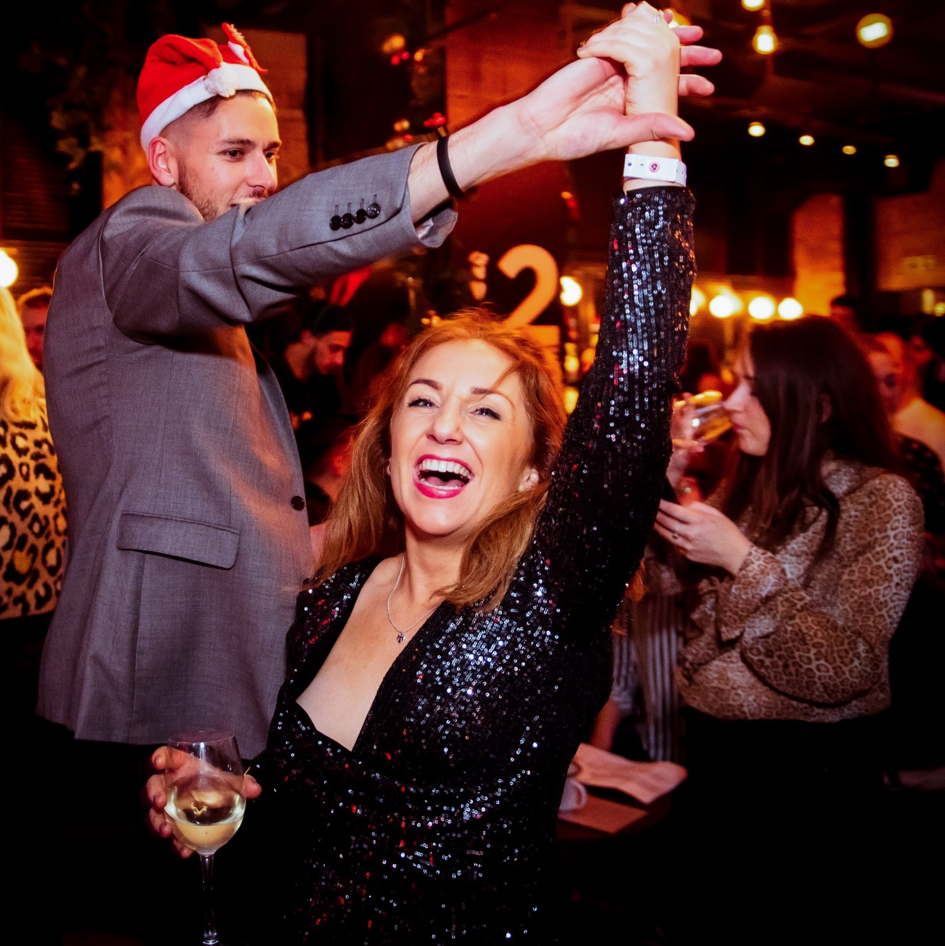
CELEBRATE CHRISTMAS WITH

Slide 2
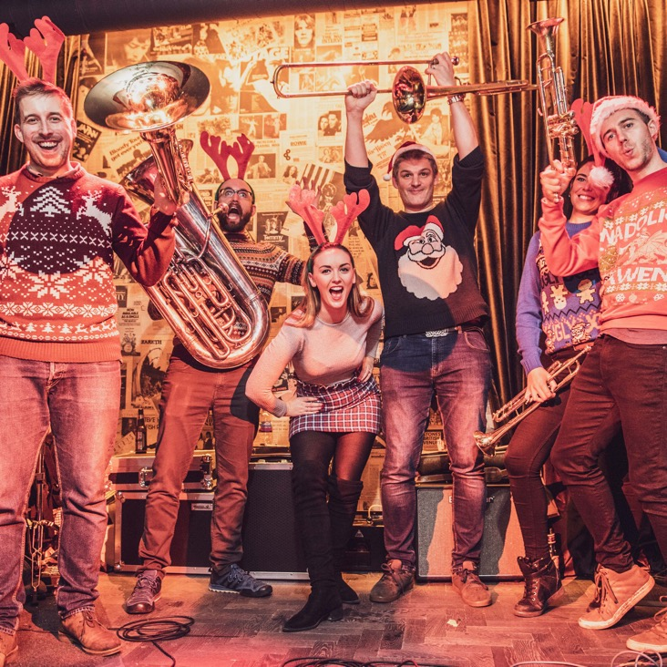
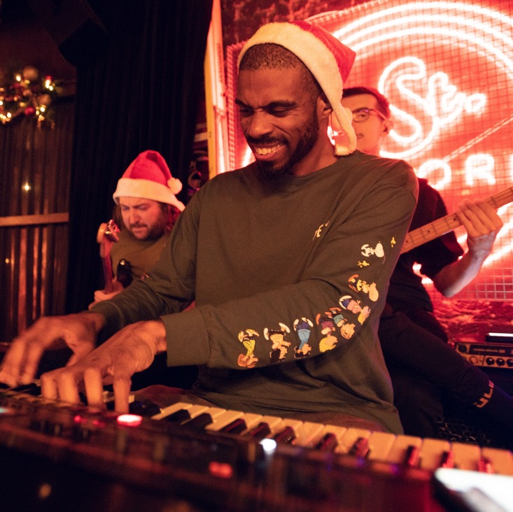
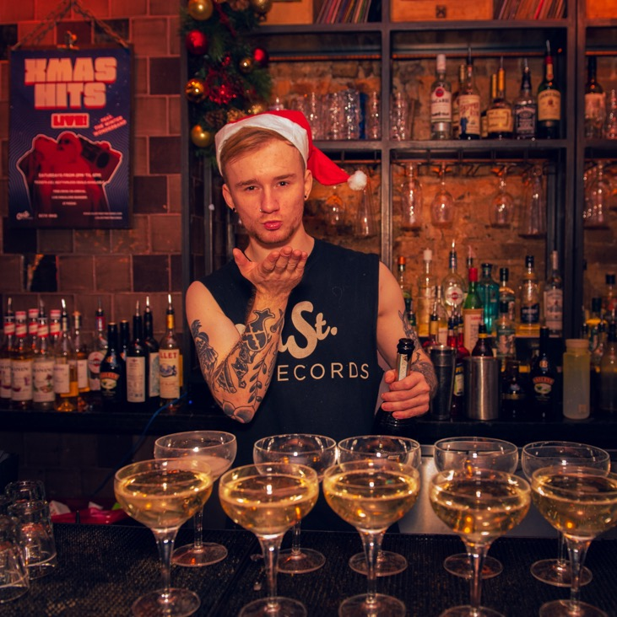
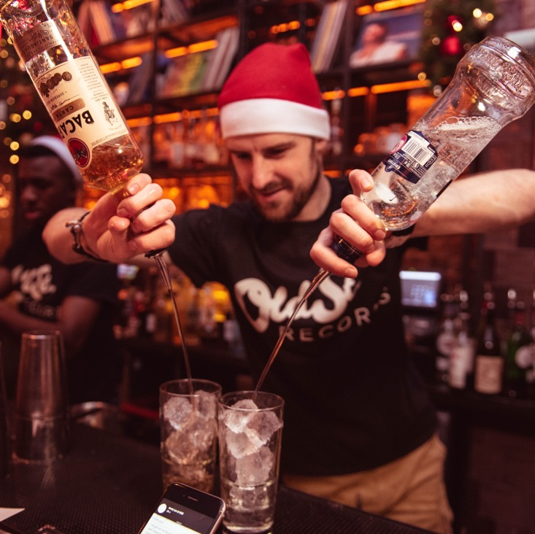
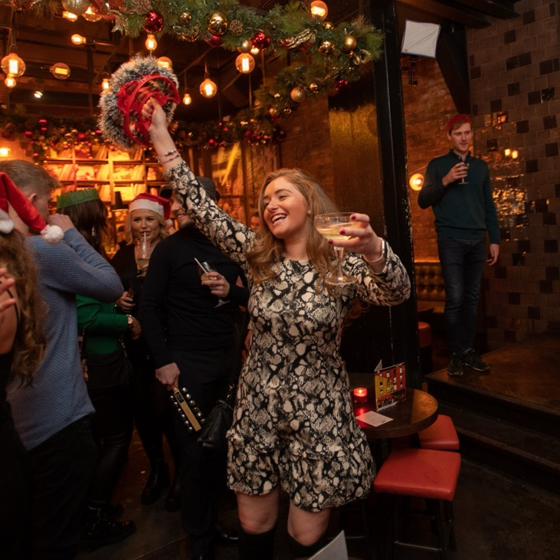
Want your Christmas party to sleigh this year? Leave it to our team to organise your best Christmas party yet.
With both private and open areas, we can help host any size and any style of festive knees-up.
There’s snow party like an
Old Street Records party.

Slide 3
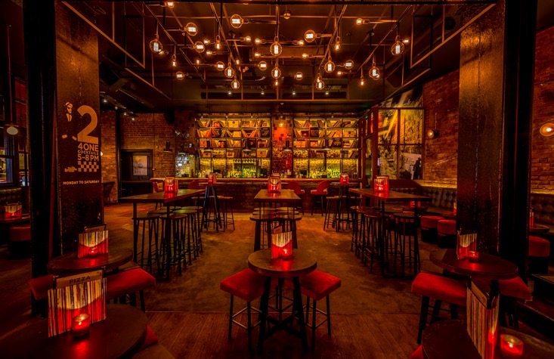
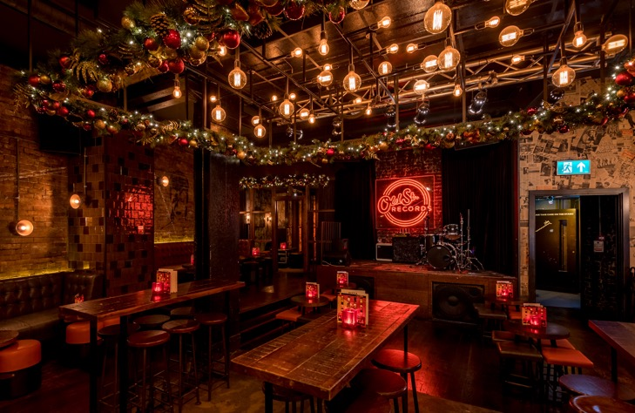
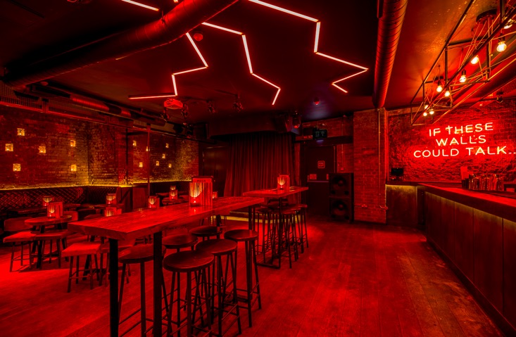
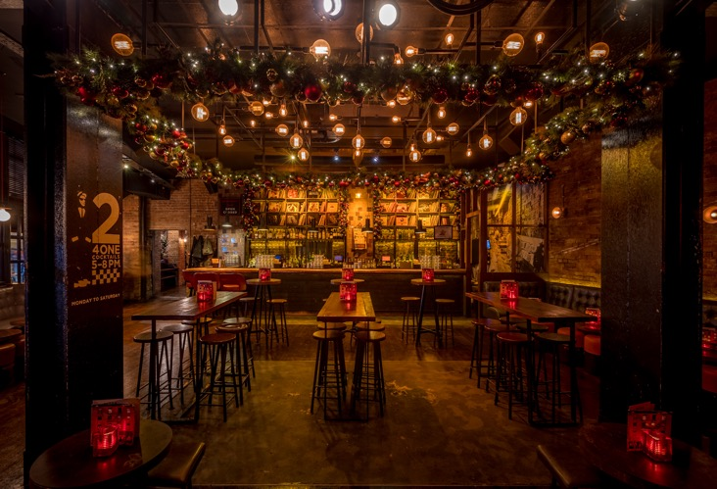
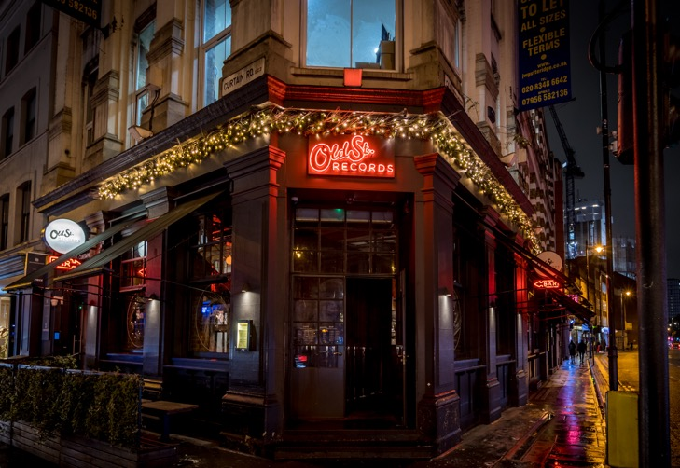
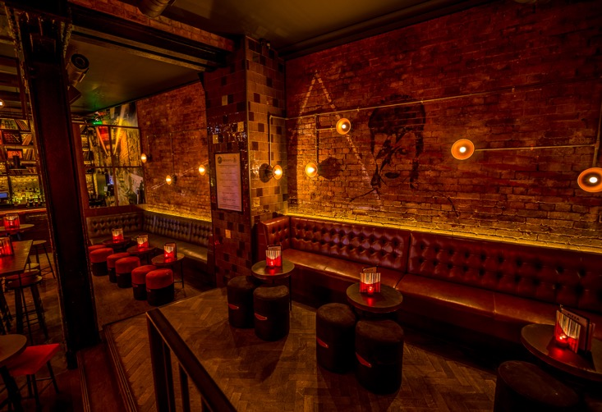
Areas
Booth Spaces
10 – 60 people
Basement
150 people
Ground Floor
230 people
Full Venue
350 people

Slide 4
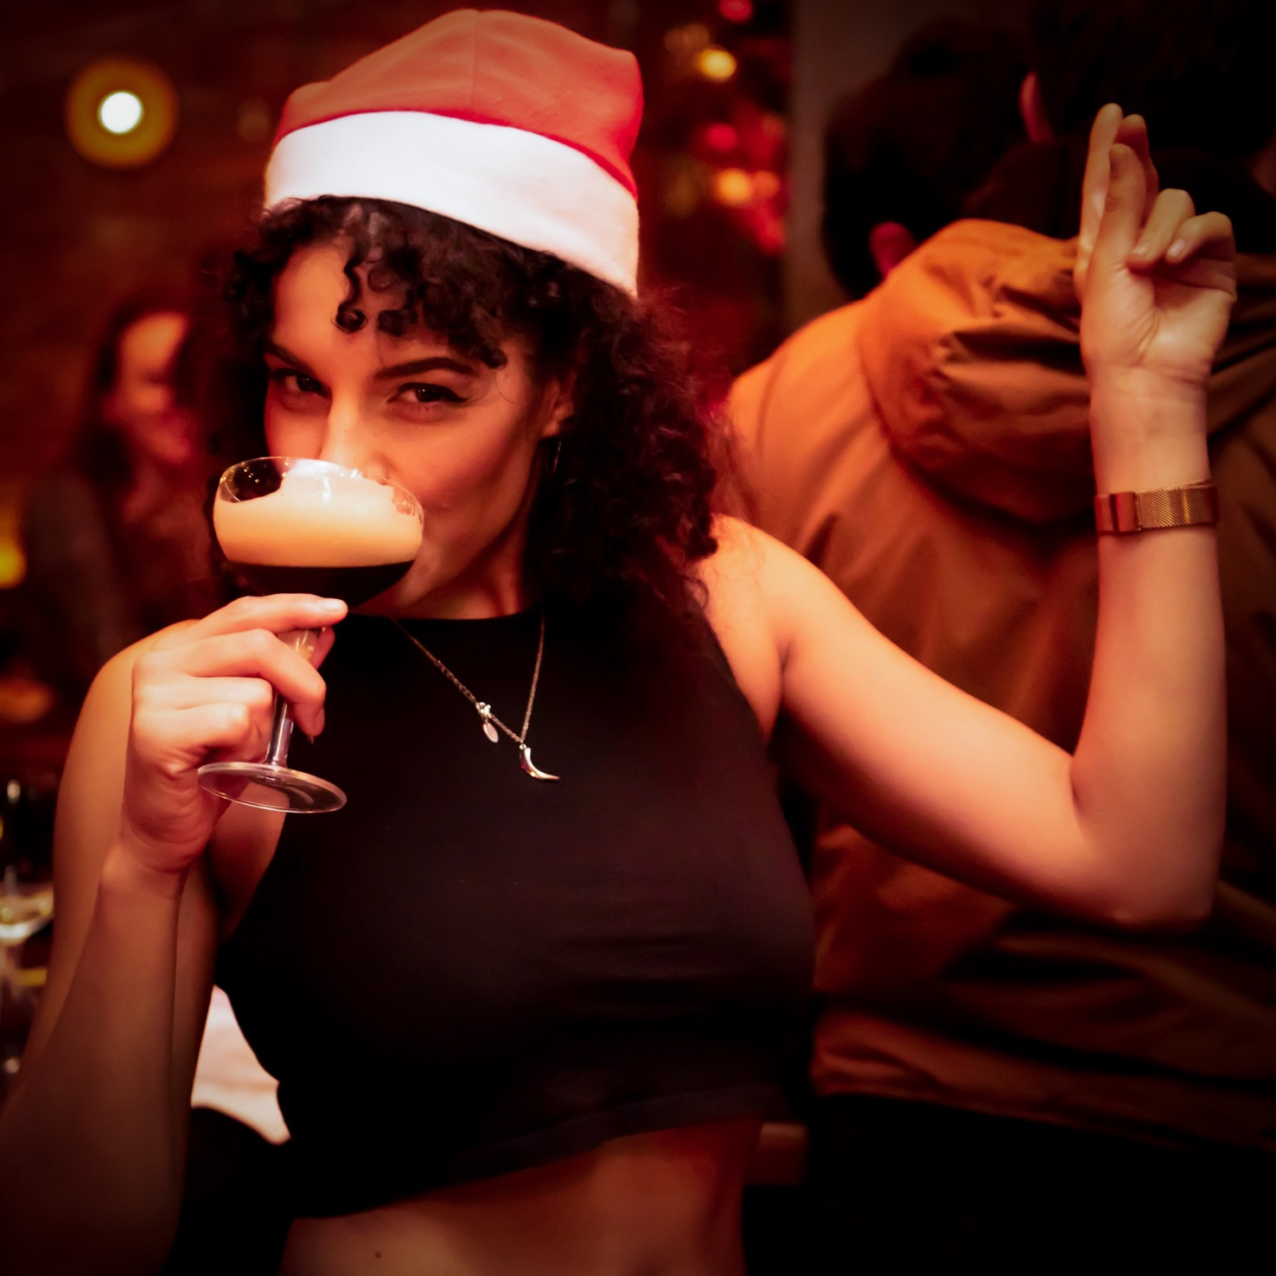
Packages
At The X-Mas Party Hop
£115
12 x Beer
6 x Pizza
Rockin’ Around
£180
2 x Prosecco
12 x Beer
6 x Pizza
Let It Snow
£300
4 x Prosecco
24 x Beer
6 x Pizza
*T&Cs apply

Slide 5
Bundles
Pizza Party: 6 Pizza £55
Prosecco Pack: 2 Prosecco £70
House Wine Bundle: 2 Bottles £40
Camden Beer Bucket: 12 Bottles £65
Bottled Cocktails
£65
Serves 12
Pornstar Martini
Mango-ho-ho (& Passionfruit Daiquiri
Records Winter Punch

Slide 6
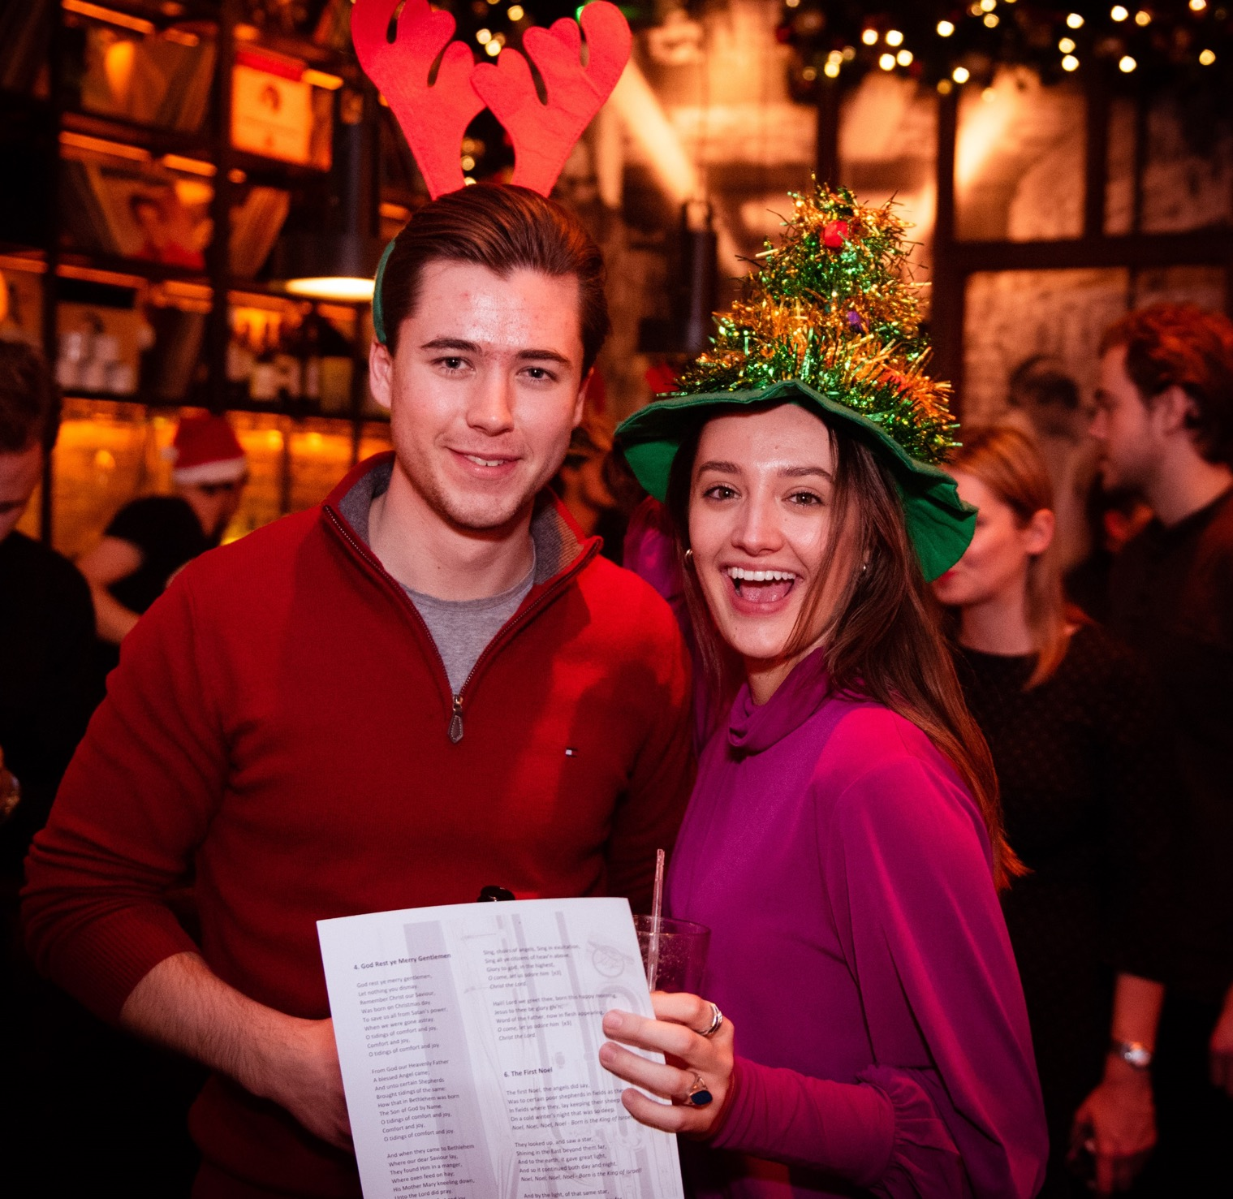
For Private Parties That Want To Get Extra Merry…
Live
Music
Presentation / Quiz
Something
Else?
Have a chat with our elves to get the right live act or DJ for you, ensuring the dance floor is pumping all night long.
Take advantage of our audio/visual equipment. Perfect for speeches, award presentations or quizzes.
From photographers and photobooths to festive decorations,
if you have any other ideas in mind, we’d be happy chat it through.

Slide 7
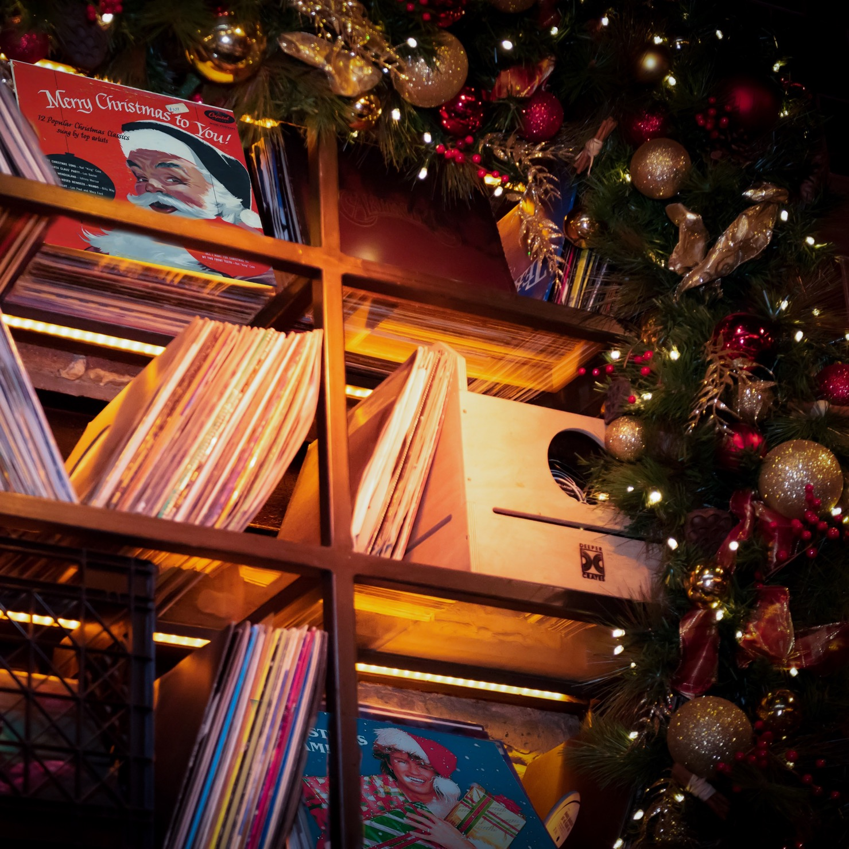
For more information or to arrange a visit,
call our events team on 0203 006 5911 or
send an email to bookings@recordsbars.com
Old Street Records, 350 – 354 Old Street, London EC1V 9NQ

